Slide 1
G. K. BHARAD INST OF ENGG
SUB:EG
SEM:1
BRANCH :CIVIL
NAME: PARMAR MIHIR 43,
VALA PARESH 6
DOBARIYA PANKAJ 12
DONGA AKSHAY 23
SOHALIYA MAYUR 8
RADADIYA JAGDISH 3

Slide 2
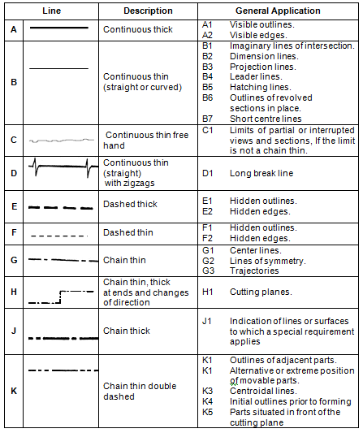
TYPES OF LINE

Slide 3
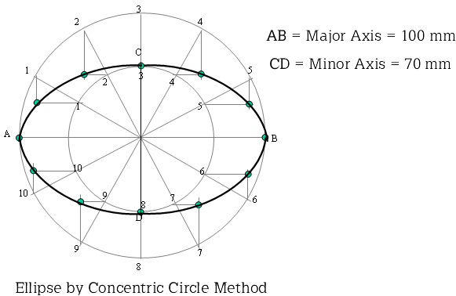
ELLIPSE-CONCENTRIC CIRCLE METHOD

Slide 4
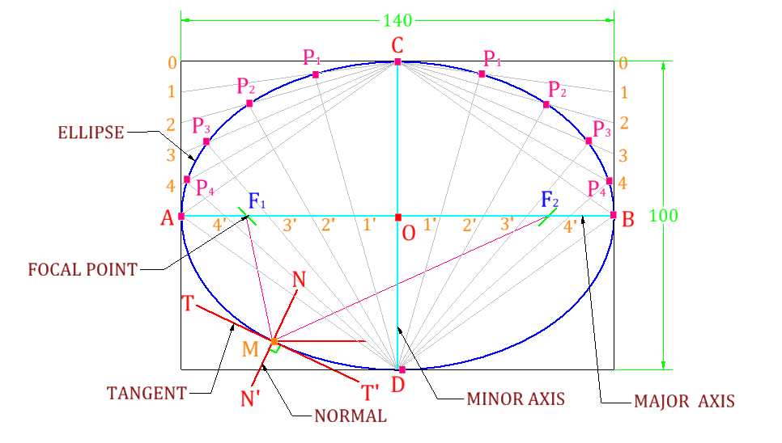
ELLIPSE-OBLONG METHOD

Slide 5
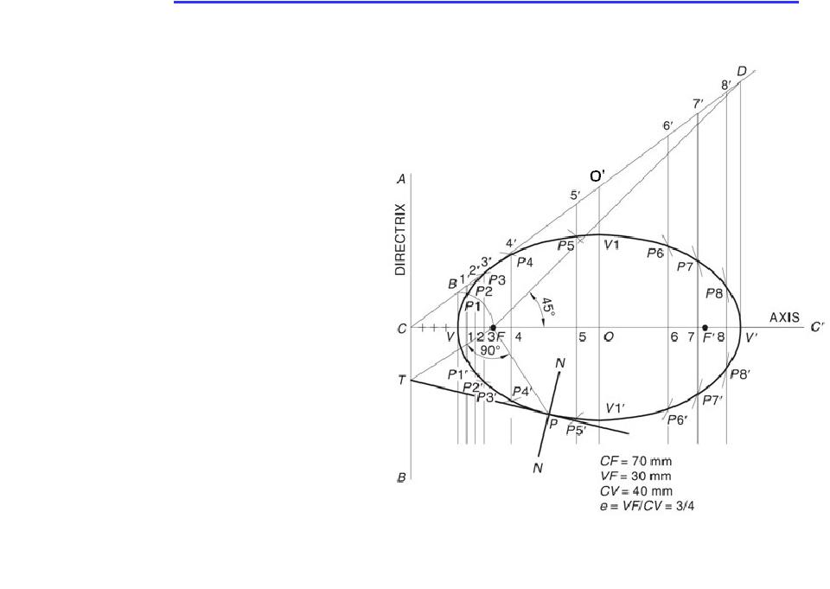
ELLIPSE -DIRECTRIX FOUS METHOD

Slide 6
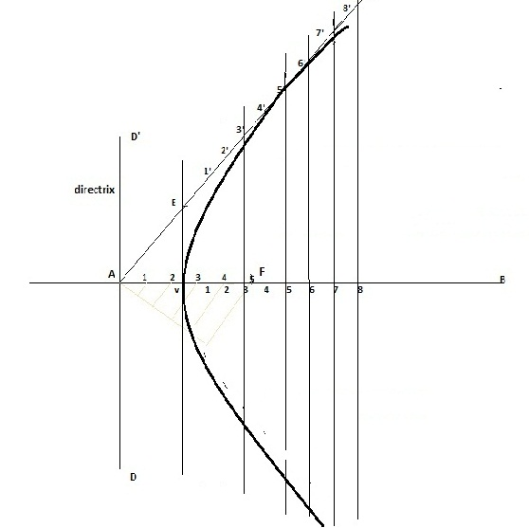
PARABOLA -RECTANGLE METHOD

Slide 7
HYPERBOLA -DIRECTRIX FOUS METHOD

Slide 8
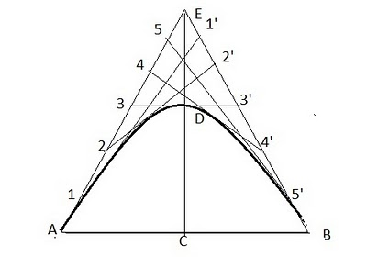
parabola -TANGENT METHOD

Slide 9
CYCLOID

Slide 10
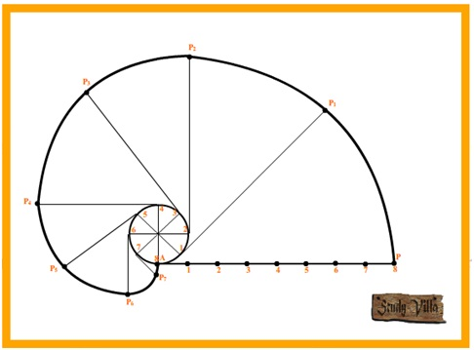
INVOLUTE OF A CIRCLE

Slide 11
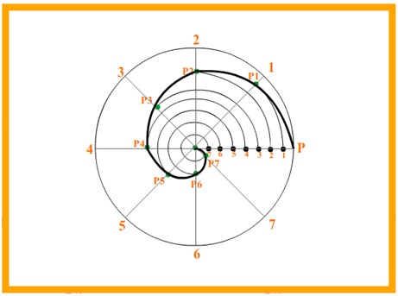
ARCHIMEDEAN SPIRAL

Slide 12
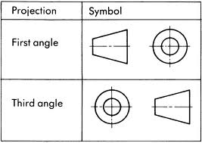
SYSTEMS OF ORTHOGRAPHIC PROJECTION

Slide 13
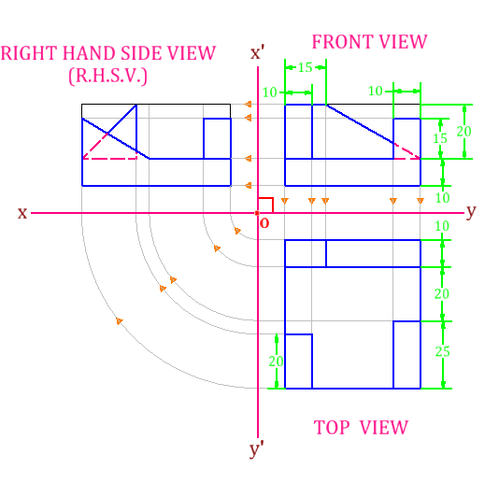
ORTHOGRAPHIC PROJECTION FIRST ANGLE

Slide 14
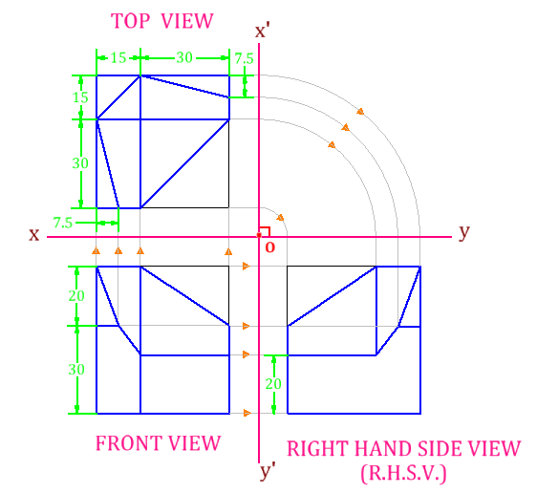
ORTHOGRAPHIC PROJECTION THIRD ANGLE

Slide 15
THANK YOU

